Slide 1


Control Systems Engineering
Lecture : 13
Dr. G. Balamurugan
Assistant Professor
Department of Electronics Engineering
MIT Campus, Anna University.
Notes:
https://slideplayer.com/slide/10719892/

Slide 2
UNIT II TIME RESPONSE ANALYSIS
Transient response-steady state response-Measures of performance of the standard first order and second order system-effect on an additional zero and an additional pole-steady error constant and system- type number-PID control-Analytical design for PD, PI,PID control systems

Slide 3
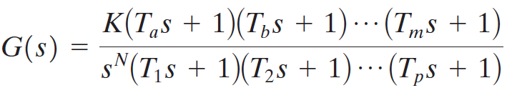
Introduction
Any physical control system inherently suffers steady-state error in response to certain types of inputs.
A system may have no steady-state error to a step input, but the same system may exhibit nonzero steady-state error to a ramp input.
Whether a given system will exhibit steady-state error for a given type of input depends on the type of open-loop transfer function of the system.
Consider the unity-feedback control system with the following open-loop transfer function
It involves the term s^{N} in the denominator, representing N poles at the origin.
A system is called type 0, type 1, type 2, ... , if N=0, N=1, N=2, ... , respectively.

Slide 4
Steady State Error
As the type number is increased, accuracy is improved.
However, increasing the type number aggravates the stability problem.
A compromise between steady-state accuracy and relative stability is always necessary.

Slide 5
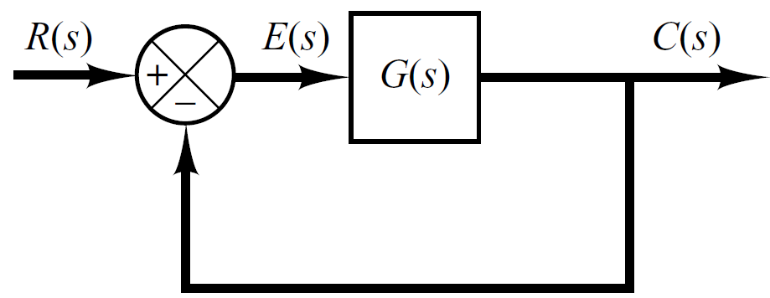





Steady State Error
Steady state error: It is the error between the actual output and the desired output as t →∞
Consider the system shown in following figure.
The closed-loop transfer function is
The transfer function between the error signal E(s) and the input signal R(s) is

Slide 6

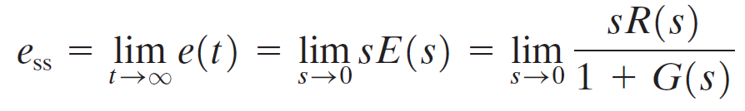

Steady State Error
The final-value theorem provides a convenient way to find the steady-state performance of a stable system.
Since E(s) is
The steady state error is

Slide 7

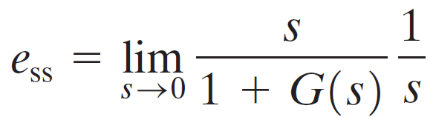



Steady State Error for standard inputs
(Unit Step Signal)
The steady-state error of the system for a unit-step input is
Where is called position error constant.

Slide 8
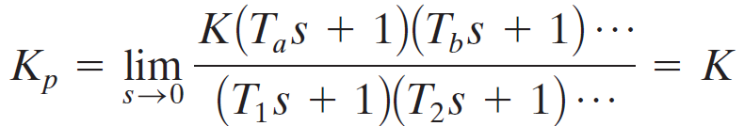
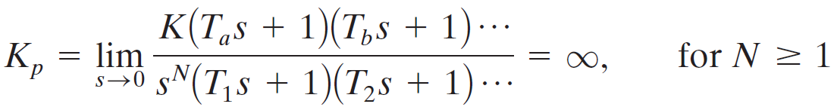
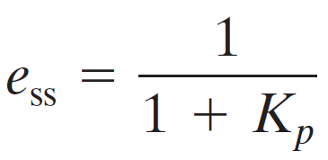




Static Position Error Constant (K_{p})
For a Type 0 system
For Type 1 or higher systems
For a unit step input the steady state error e_{ss} is

Slide 9

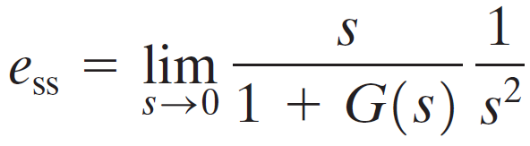

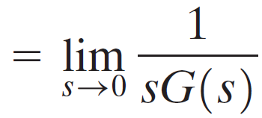

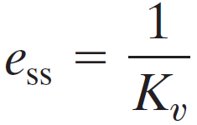
Steady State Error for standard inputs
(Unit Ramp Signal)
The steady-state error of the system for a unit-ramp input is
The static position error constant K_{v} is defined by
Thus, the steady-state error in terms of the static velocity error constant K_{v} is given by

Slide 10
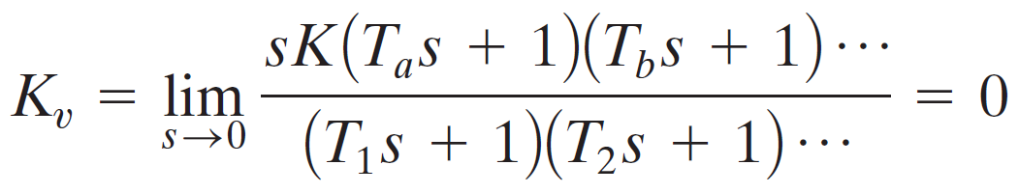
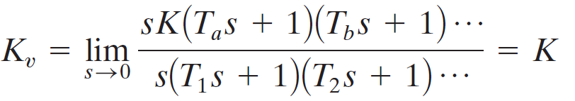
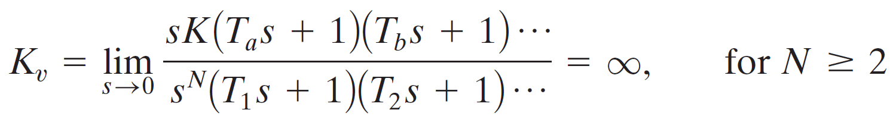

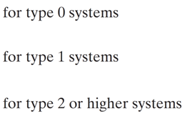


Static Velocity Error Constant (K_{v})
For a Type 0 system
For Type 1 systems
For Type 2 or higher systems
For a ramp input the steady state error e_{ss} is

Slide 11




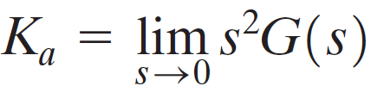
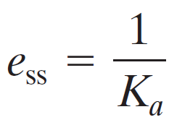
Steady State Error for standard inputs
(Unit Parabolic Signal)
The steady-state error of the system for parabolic input is
The static acceleration error constant K_{a} is defined by
Thus, the steady-state error in terms of the static acceleration error constant K_{a} is given by

Slide 12

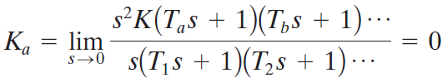
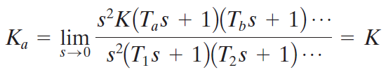
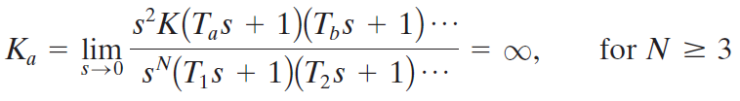


Static Acceleration Error Constant (K_{a})
For a Type 0 system
For Type 1 systems
For Type 2 systems
For Type 3 or higher systems
For a parabolic input the steady state error e_{ss} is

Slide 13
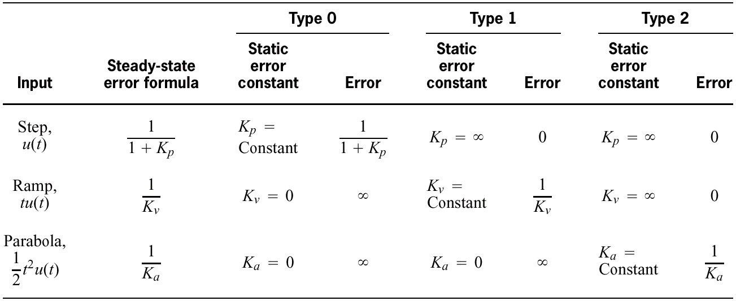
Summary
Relationships between input, system type, static error constants, and steady-state errors

Slide 14
Problem 1
For the system shown in figure below evaluate the static error constants and find the expected steady state errors for the standard step, ramp and parabolic inputs.
R(S)
C(S)
-

Slide 15
Problem 1
Evaluation of Static Error Constants

Slide 16
Steady State Error
Evaluation of Steady State Errors

Slide 17
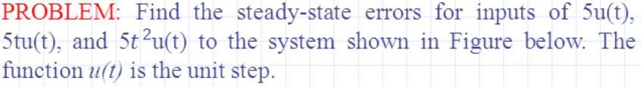
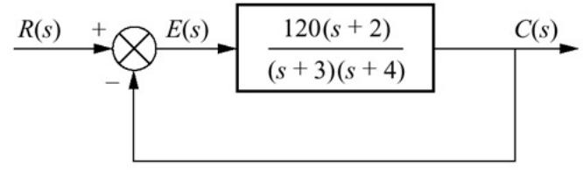






Problem 2

Slide 18
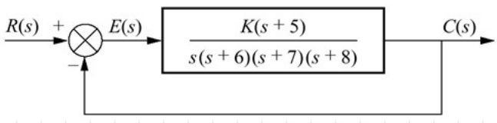
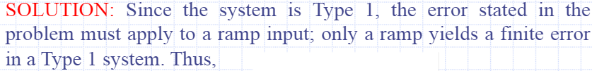



Problem 3

Slide 19






Problem 4
For a closed loop system whose open loop transfer function
Find the steady state error when the input is

Slide 20









Problem 4

Slide 21
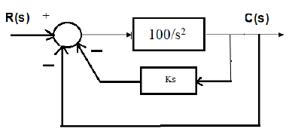
Problem 5
The block diagram of a unity feedback control system with inner output derivative feedback is shown below.
i) Calculate the steady state error for unit ramp input.
ii) Choose the value of K such that the unit step response of the system has no over shoot and yet it is as fast as possible

Slide 22






Problem 5

Slide 23

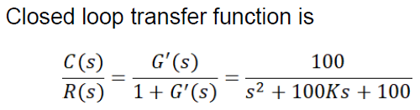







Problem 4

Slide 24

Thank You
Thank You

